Slide 1
DEEP REINFORCEMENT LEARNING
RESHMI GHOSH,
DATA AND APPLIED SCIENTIST II, MICROSOFT

Slide 2
ABOUT ME
Currently a Data & Applied Scientist, Microsoft
Ph.D. & M.S. from Carnegie Mellon University
Teaching Assistant for 11-785 in Fall 2020 and Spring 2021
Thesis on stochastic modeling & novel Deep Learning based sequential analysis to make energy systems more robust under climate change

Slide 3

Contents
Reinforcement Learning Formulation
Examples of RL
Markov Decision Process
Q-Learning
Need to combine Deep Learning with Reinforcement Learning
Problems with Deep Q-Learning
Bandit algorithms
Multi-arm bandits
Contextual Bandits
Product use-case

Slide 4

Bhiksha’s fan ☺ and believer of meme threads on Piazza

Slide 5
HOW IS REINFORCEMENT LEARNING DIFFERENT FROM ML/DL?
Statistics - Understand data distribution, the dispersion of data points, methods to tell how two groups of data are different
Machine Learning - Based on existing data representation – you teach a ‘machine’ to recognize patterns and predict it
Deep Learning - A fancier version of machine learning where your machine recognizes decision boundaries which are non-linear in nature – a function approximator
Reinforcement Learning - Teach a ‘machine’ how to decide (ACTION) based on a ‘prior’ understanding of the environment (STATE) and possible outcomes (REWARDS) of the decision(subset of ML/DL algorithms)
Notes:
Imitation Learning – learn from experience of others – observes another intelligent agent and

Slide 6




REINFORCEMENT LEARNING FRAMEWORK
ACTION
REWARDS
ENVIRONMENT
STATES
What does an agent decide to do?
Is the decision right or wrong?
In what conditions is the agent operating?
What are possible ‘environments’ the agent can transition into after making a decision?
Notes:
How an agent interacts with its environment to ultimately maximize cumulative reward? Learn a function that determines what action to take in a given state such that the total expected future reward is maximized – Such a function is called policy

Slide 7

Reinforcement Learning Examples
A game of chess
States: What influences your action?
Actions: Which move to choose?
Reward: What do you gain or lose?
Robots completing a certain task
States: ?
Actions: ?
Reward:?
Notes:
So let’s talk try to define the action, reward, and states for each of these situations. In a game of chess, you are sitting down with an opponent (which is the environment), your opponent makes a move and you only have only so many finite moves to counter that, which is your actions at any time t, after your opponent makes the move, you are in a new situation – that is your state, and based on what action you take, you will be either one step closer to winning or losing the game
Next, let’s think about a robot (for example a self driving car) on the road trying to go from destination A to B – can someone tell me

Slide 8
Reinforcement Learning Examples
A game of chess
States:
Actions: Which move to choose?
Reward: What do you gain or lose?
Robots completing a certain task
States: Observation from sensors
Actions: What is the next move?
Reward:
Appreciation for the correct move towards completion of task
Penalty for unexpected moves, accidents
Notes:
So let’s talk try to define the action, reward, and states for each of these situations. In a game of chess, you are sitting down with an opponent (which is the environment), your opponent makes a move and you only have only so many finite moves to counter that, which is your actions at any time t, after your opponent makes the move, you are in a new situation – that is your state, and based on what action you take, you will be either one step closer to winning or losing the game
Next, we will transition to see mathematically how do we formulate these actions, rewards, and states in a logical way to implement our Reinforcement Learning algorithm

Slide 9


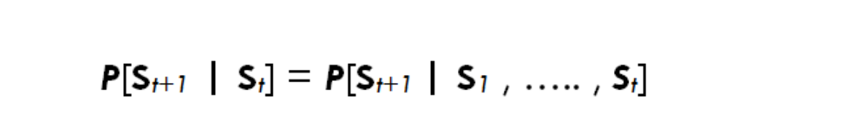
Markov Property
AI must be able to deal with series of tasks and reach a goal
Markov property: agent keeps track of how the changes occur from previous state to current state
“Future is independent of the past given the present”
state₁
state_{n}
Transition probability: The probability that the agent will move from one state to another
From state S_{t} to S_{t+1}, the state transition probability is given by P_{ss’} = P(S_{t+1} = s’ | S_{t} = s)
We can also define a state Transition probability matrix
Notes:
Let’s talk about how transitions are typically defined between states and for this we leverage the Markov Property –
The Markov property states that Future is independent …. The equation means that the transition from state St to St+1 is entirely independent of the past
Intuitively meaning that our current state already captures the information of past states
And every transition thus is a probabilistic function of where your agent could go next

Slide 10
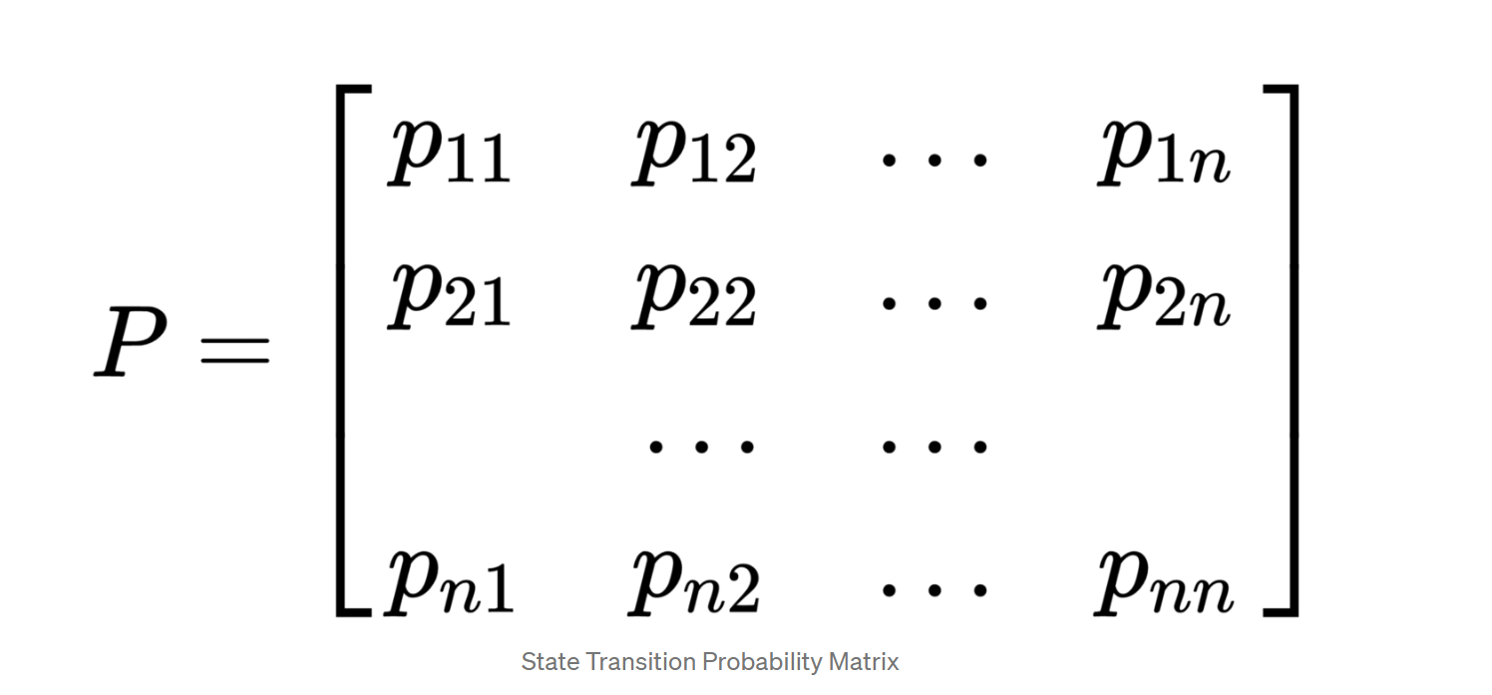
Markov Property
AI must be able to deal with series of tasks and reach a goal
state₁
state_{n}
Transition probability: The probability that the agent will move from one state to another
From state S_{t} to S_{t+1}, the state transition probability is given by P_{ss’} = P(S_{t+1} = s’ | S_{t} = s)
We can also define a state Transition probability matrix
Each row represents the probability from moving from current state/original state
Sum of each row = 1
Notes:
So the transitions between states can really be defined as a matrix where each row represents the probability of going from

Slide 11

Markov Reward Process
Mathematically
R_{s} = E[R_{t+1} | S_{t} ]
How much reward (R_{s}) we get from a particular state S_{t}
Notes:
So we understood how Markov property defined the dynamics of a state transition, but reinforcement learning is all about maximizing the reward for a specific task. So let’s add reward to the Markov chain which gives us the Markov Reward Process.

Slide 12
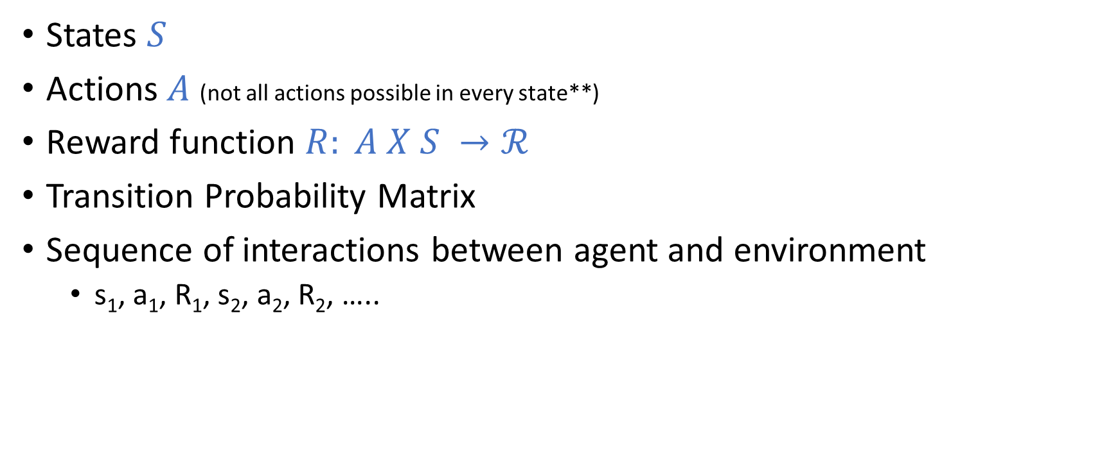
Markov Decision Process (MDP) – Model based
States $S$
Actions$A$ (not all actions possible in every state**)
Reward function $R: A X S →ℛ$
Transition Probability Matrix
Sequence of interactions between agent and environment
s₁, a₁, R₁, s₂, a₂, R₂, …..
Notes:
MDP is a MRP with decisions. Everything is same as MRP but now the agent makes decisions meaning it actually takes some actions
Our reward is dependent on the action – until now we spoke about how we get a reward when our agent transitions through a set of states following some strategy (which is basically called policy, something we will discuss in the next slides)
Transition function

Slide 13


Policy
Strategy employed by agent to determine the next action based on the current state
A mechanism to take decisions
Maps state to actions, specifically the actions that result in largest reward
Should be tractable
Cannot be a set of if-else conditions
∏(a|s) policy
Notes:
Value algorithm
Initialize V(s) arbitrarily
Loop until policy is good enough
Loop for s $ε S$
Loop for a $ε A$
Q(s, a):= R(s,a) + $γ\sum_{s^{′}ε S}{T\left(s, a, s^{′}\right)V^{∗}\left(S^{′}\right)})$
V(s) := max_a Q(s,a)
Policy algorithm
Choose an arbitrary policy

Slide 14



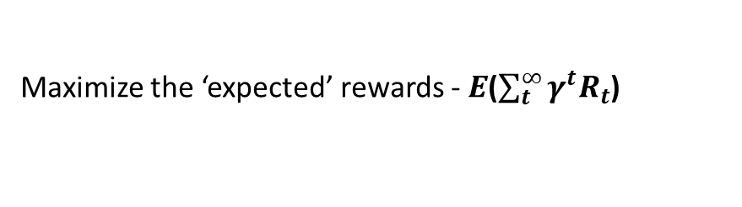
Optimal Policy
Maps state to actions, specifically the actions that result in largest reward
Should be tractable
Cannot be a set of if-else conditions
Considers a set of past experience
To make the agent behave optimally – it needs to learn how to choose the best action for each state, i.e., optimal policy
Infinite Horizon: include a discounting factor $γ$
Maximize the ‘expected’ rewards - $E$($\sum_{t}^{∞}{γ^{t}R_{t}}$)
Notes:
Can anyone tell me why are we even bothered about the

Slide 15
Optimal Policy
Maps state to actions, specifically the actions that result in largest reward
Should be tractable
Cannot be a set of if-else conditions
Considers a set of past experience
To make the agent behave optimally – it needs to learn how to choose the best action for each state, i.e., optimal policy
How do we define the discount factor? - Arbitrarily set to 0.9
Infinite Horizon: include a discounting factor $γ$
Maximize the ‘expected’ rewards - $E$($\sum_{t}^{∞}{γ^{t}R_{t}}$)
Notes:
Talk about discount factor?
SO do you want to have a uniform discount factor? This is where practice differs from theory. Depending on the task you will want to decide on if it makes sense to assign more weightage to decisions in near future than for actions near the terminal state.
For example – Imagine you have a product website that makes money through ads. A customer interfaces with this website to look for something, do you want a customer to click a news article which shows them somewhat relevant ads or do you want to collect more information about customer behavior and show more relevant ads as they are navigating through different web pages of your website.
Policies in the MDP depend on the current state, they do not depend on history – following the Markov property.
n a chess game, the goal is to defeat the opponent’s king. If we give importance to the immediate rewards like a reward on pawn defeat any opponent player then the agent will learn to perform these sub-goals no matter if his players are also defeated. So, in this task future rewards are more important. In some, we might prefer to use immediate rewards like the water example we saw earlier.

Slide 16
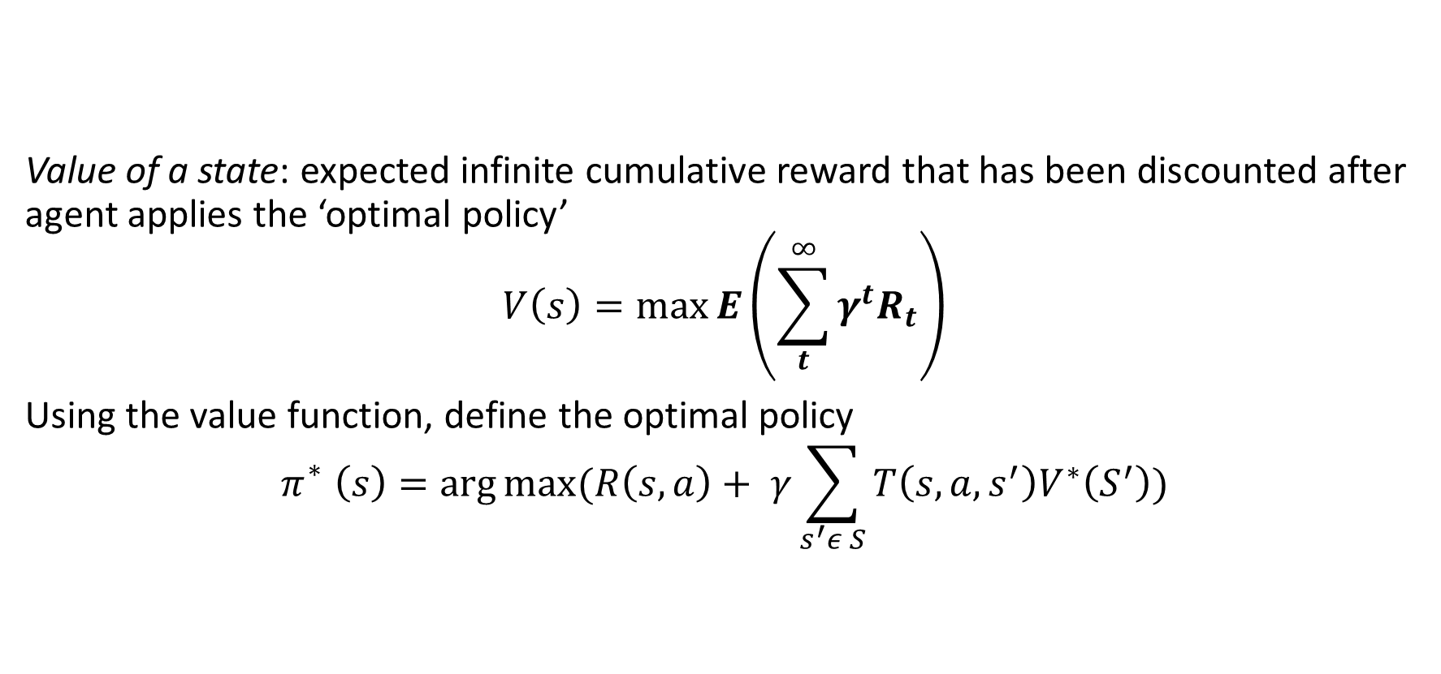
Optimal Policy
Value of a state: expected infinite cumulative reward that has been discounted after agent applies the ‘optimal policy’
$$V\left(s\right)=\max{E\left(\sum_{t}^{∞}{γ^{t}R_{t}}\right)}$$
Using the value function, define the optimal policy
$$π_{}^{∗}\left(s\right)=\arg{\max{(R\left(s, a\right)+ γ\sum_{s^{′}ε S}{T\left(s, a, s^{′}\right)V^{∗}\left(S^{′}\right)})}}$$
Notes:
Value algorithm : Value of any state s is the expected return starting from state s and following policy pi for the next steps until we reach the terminal state of the end. The important thing to note here is that value of a state is not a stochastic parameter as we find the expectation of rewards, but returns is stochastic. This function is also called the state-value function
Initialize V(s) arbitrarily
Loop until policy is good enough
Loop for s $ε S$
Loop for a $ε A$
Q(s, a):= R(s,a) + $γ\sum_{s^{′}ε S}{T\left(s, a, s^{′}\right)V^{∗}\left(S^{′}\right)})$
V(s) := max_a Q(s,a)
Policy algorithm
Choose an arbitrary policy

Slide 17

AI PLANNING: EXPLORATION Vs. EXPLOITATION
How does agent learn optimal policy?
Needs to evaluate every possible action for all (infinite) states.
What if the agent chooses an action that it thinks is best all the time? – unexplored parts of state space ignored.
What if the agent chooses to explore extensively? How to leverage (exploit) what the agent has learned?
Delayed consequences
Notes:
You have a view of the world
Delayed consequences
Temporal credit assignment
Exploration needed even after optimal policy convergence to adapt to small perturbations in the environment

Slide 18



Q-learning – Model free
We cannot always accurately model the state transition probabilities
Easy to define value functions
No explicit need to model Reward and Penalty functions

Slide 19
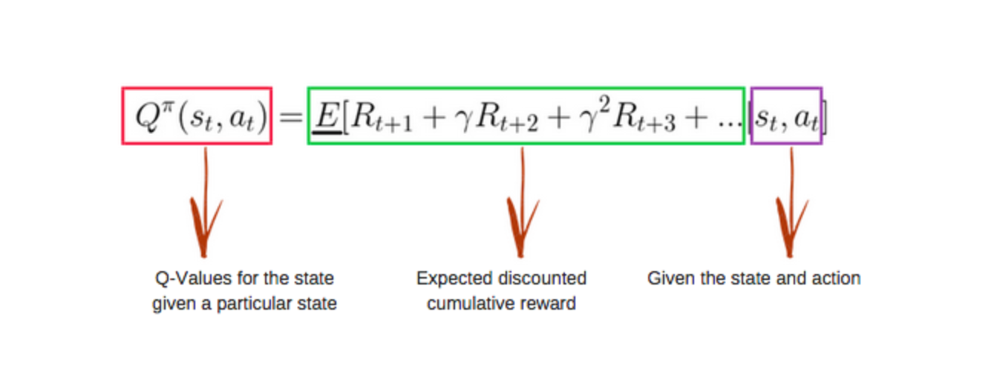

Q-learning over MDP
No transition function – approximate value of each state based on the actions taken and rewards/penalty received
$$π^{∗}\left(s\right)=argmax Q^{∗}(s, a)$$
Observe transition (s, a, r, s’)
$$Q\left(s,a\right)=\left(1−α\right)Q\left(s,a\right)+α(r+ γ\max{Q\left(s^{′}, a^{′}\right)})$$

Slide 20
Q-learning over MDP
Q-values are initialized as zeros – and through an iterative process of exploring environment, approximating state and rewards, the values are updated
Notes:
In practice value iteration is impractical

Slide 21
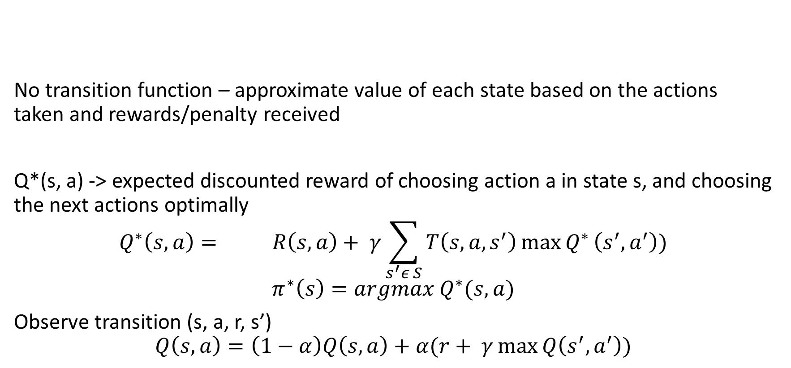
Q-learning over MDP
No transition function – approximate value of each state based on the actions taken and rewards/penalty received
Q*(s, a) -> expected discounted reward of choosing action a in state s, and choosing the next actions optimally
$$Q^{∗}\left(s, a\right)={{R\left(s, a\right)+ γ\sum_{s^{′}ε S}{T\left(s, a, s^{′}\right){\max{Q}}^{∗}\left(s^{′}, a^{′}\right)})}}$$
$$π^{∗}\left(s\right)=argmax Q^{∗}(s, a)$$
Observe transition (s, a, r, s’)
$$Q\left(s,a\right)=\left(1−α\right)Q\left(s,a\right)+α(r+ γ\max{Q\left(s^{′}, a^{′}\right)})$$

Slide 22
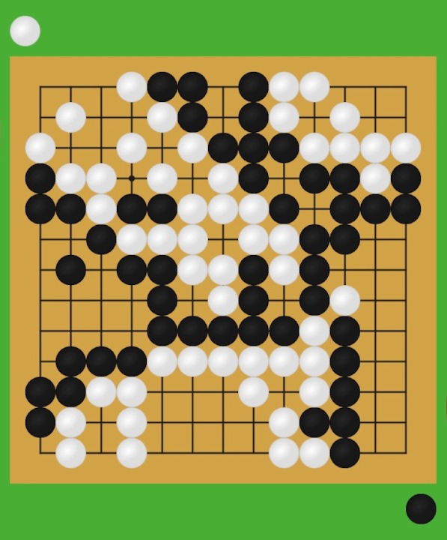
COMPLEX SCENARIo - GO GAME
19x19 different positions
3 DIFFERENT STRATEGIES – BLACK STONE, WHITE STONE, NO STONE
Possible number of states? 3^{19X19}
Impossible to learn the transition matrix – instead approximate it
What is the best way to approximate a function?
Hence, Deep Reinforcement learning
State and actions are not always discrete + difficult to store all possible states and action values
**Convergence is not guaranteed for models with function approximation
Notes:
Let’s consider the Go-Game, where you have to maximize your presence on the board by

Slide 23
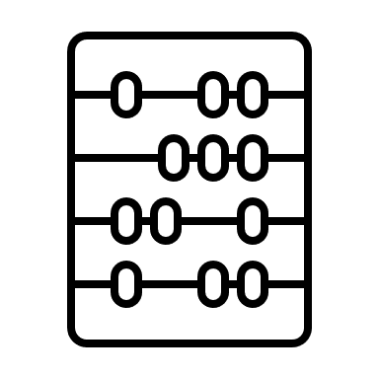



Deep Q-Networks
Deep Q-Networks Neural Networks + Q-values
Agent learns from experience
Q-value functions estimated using a neural network model
States
Neural Network model
Q-values (outputs)
All past experiences by agent stored in memory

Slide 24
Deep Q-Networks
Deep Q-Networks Neural Networks + Q-values
Agent learns from experience
Q-value functions estimated using a neural network model
States
Neural Network model
Q-values (outputs)
All past experiences by agent stored in memory
Inputs are constantly changing – different from conventional Deep Learning formulations

Slide 25
Deep Q-Learning
Q-value
Network
States
Action
Use DNN to approximate Q functions
Use observed trajectories of state-action-rewards
‘Human level control through Deep Reinforcement Learning’, 2015 – by DeepMind
Feed the network with state-action pair to output a corresponding Q-value

Slide 26
Deep Q-Learning
Q-value 1
Q-value 2
Q-value n
Network
States
Use DNN to approximate Q functions
Use observed trajectories of state-action-rewards
‘Human level control through Deep Reinforcement Learning’, 2015 – by DeepMind
Compute Q-values for all actions in one go

Slide 27
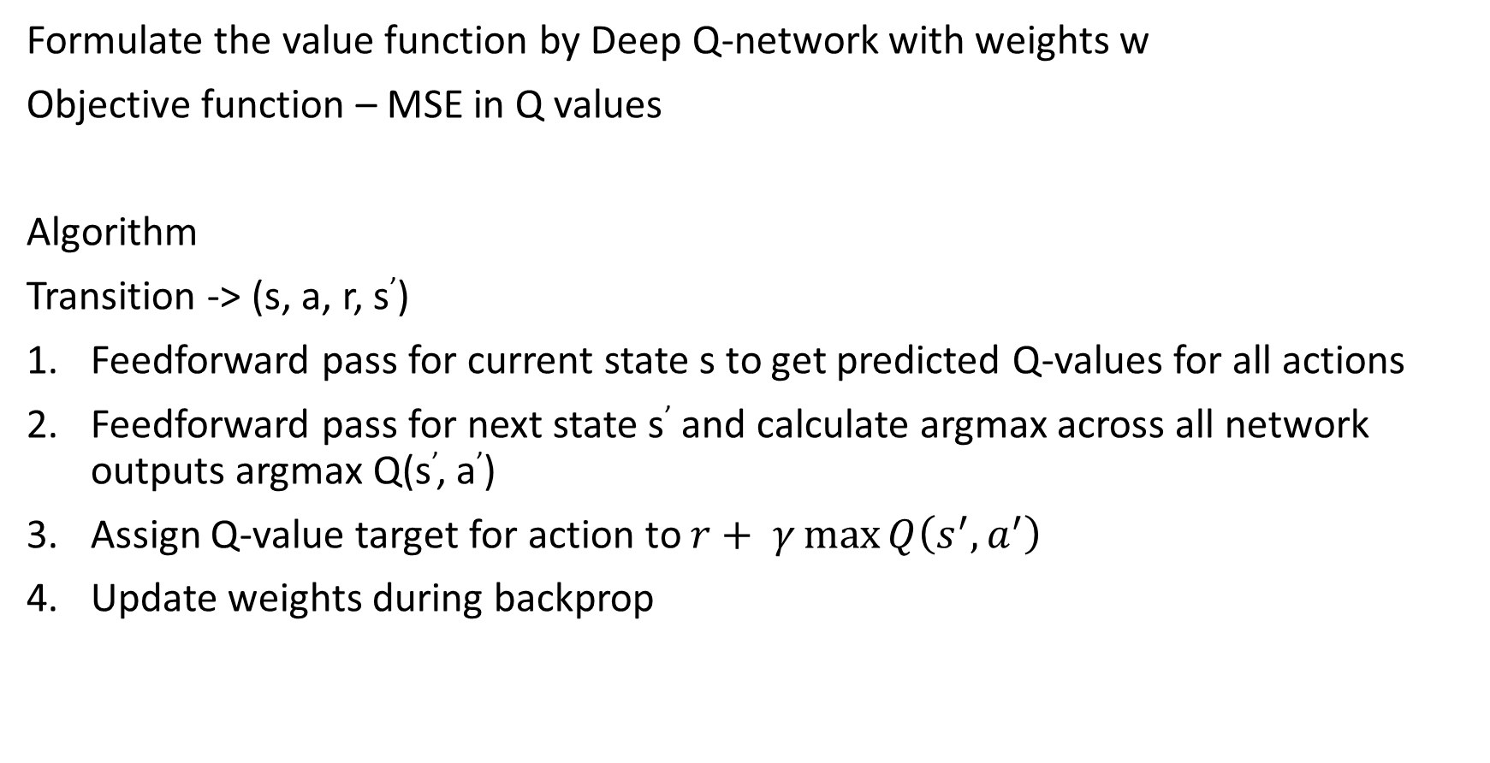
Deep Q-Learning formulation
Formulate the value function by Deep Q-network with weights w
Objective function – MSE in Q values
Algorithm
Transition -> (s, a, r, s’)
Feedforward pass for current state s to get predicted Q-values for all actions
Feedforward pass for next state s’ and calculate argmax across all network outputs argmax Q(s’, a’)
Assign Q-value target for action to $r+ γ\max{Q\left(s^{′}, a^{′}\right)}$
Update weights during backprop
Notes:
Agent aims to ma

Slide 28
Pitfalls
Policy changes frequently with small changes to Q-values, may oscillate
Compute Q-learning targets w.r.t old, fixed parameters w
Scale of rewards and Q-values – unknown, thus gradients can be large and unstable
Clip rewards or normalize network adaptively
Experience Replay!
Notes:
The caveat to these novel deep Q-learning formulation is the significant amount of instability during training. Imagine you are trying to train a RL model in a multi-player game setting, to play as the opponent. Your training set is essentially a collection of screenshots of various time stamps of the game, but since these screenshots are highly correlated to each other the Deep learning model overfits very easily. Your model is doing gradient descent on similar correlated inputs

Slide 29
Problems with stability
Off-policy learning
Learning from data generated by a policy about a different policy – better value approximation for the policy actually being implemented
Bootstrapping
Learning value estimates from other value estimates
Q-learning diverges in presence of:

Slide 30


Bandit Algorithms
A bandit is a metaphor for slot machine in a casino
Introduced by William R. Thompson, clinical trials being the first intended applications (predicting what drug should a certain patient receive)
Payoffs have a random probability when you pull the lever of an armed bandit. Do you keep pulling the lever of the same bandit (slot-machine), or do you want to try your luck with other slot machines?
Captures the fundamental dilemma a learner faces when choosing between uncertain options

Slide 31
Bandit Algorithms
A bandit is a metaphor for slot machine in a casino
Introduced by William R. Thompson, clinical trials being the first intended applications (predicting what drug should a certain patient receive)
Payoffs have a random probability when you pull the lever of an armed bandit. Do you keep pulling the lever of the same bandit (slot-machine), or do you want to try your luck with other slot machines?
Captures the fundamental dilemma a learner faces when choosing between uncertain options
Repeatedly choose between actions with unknown payoffs – maximize the cumulative gain
Exploit the best payout option found until now

Slide 32
Multi-arm Bandit Algorithms
Imagine trying your luck with multiple slot machines (multiple one-armed bandits)
You need to develop an intuition between finding the machines that has greater payoff and *exploiting* the machine which has the greatest payout so far.
What do you do?

Slide 33
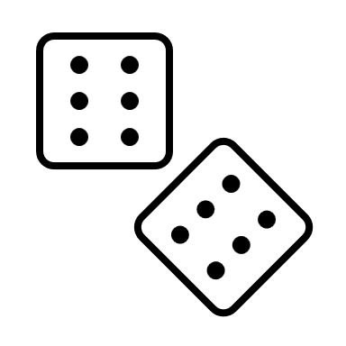
Multi-arm Bandit Algorithms
Imagine trying your luck with multiple slot machines (multiple one-armed bandits)
You need to develop an intuition between finding the machines that has greater payoff and *exploiting* the machine which has the greatest payout so far.
What do you do?
Your intuition without ‘any external information’ is random – i.e. you will randomly try to decide which lever to pull next

Slide 34
Multi-arm Bandit Algorithms
Imagine trying your luck with multiple slot machines (multiple one-armed bandits)
You need to develop an intuition between finding the machines that has greater payoff and *exploiting* the machine which has the greatest payout so far.
What do you do?
Your intuition without ‘any external information’ is random – i.e. you will randomly try to decide which lever to pull next
Stateless – you operate without any perception of the external environment changes after every lever you click

Slide 35
Multi-arm Bandit Algorithms
What do you do?
Your intuition without ‘any external information’ is random – i.e. you will randomly try to decide which lever to pull next
Action
Reward
Stateless – you operate without any perception of the external environment changes after every lever you click
Stateless
State
Action
Reward
Full RL framework
Notes:
Imagine you are trying to create this website showing pictures of cats and dogs to an user – and the website makes random decisions of showing any picture without the context of the user

Slide 36
Multi-arm Bandit Algorithms
What do you do?
Your intuition without ‘any external information’ is random – i.e. you will randomly try to decide which lever to pull next
Action
Reward
Stateless – you operate without any perception of the external environment changes after every lever you click
Stateless
State
Action
Reward
Your bandit (slot-machine) selection strategy is Policy ∏
Full RL framework
Notes:
Imagine you are trying to create this website showing pictures of cats and dogs to an user – and the website makes random decisions of showing any picture without the context of the user

Slide 37

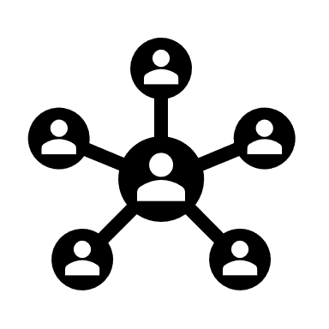
Multi-arm Bandit Algorithms (MAB) Caveats
What do you do?
Random intuition to choose the next action (in our case, pulling the lever of a slot machine) – is not suited for practical setting
Knowledge of the problem setting (state) is very important to deploy appropriate actions
Consider applying MAB to ad recommendations and machine failure – and every time making the same choice irrespective of considering the user/machine characteristics
Notes:
Imagine you are trying to create this website showing pictures of cats and dogs to an user – and the website makes random decisions of showing any picture without the context of the user

Slide 38

Contextual Bandit Algorithms
Agent has access to additional information about the ‘situation’ at beginning of each action round
Specializing actions to context – better rewards
Notes:
Imagine you are trying to create this website showing pictures of cats and dogs to an user – and the website makes random decisions of showing any picture without the context of the user

Slide 39

Contextual Bandit Algorithms
Agent has access to additional information about the ‘situation’ at beginning of each action round
Specializing actions to context – better rewards
Context
State
Action
Reward
State
Action
Reward
Full RL framework
Notes:
Learning about the env, making decisions and collecting rewards

Slide 40
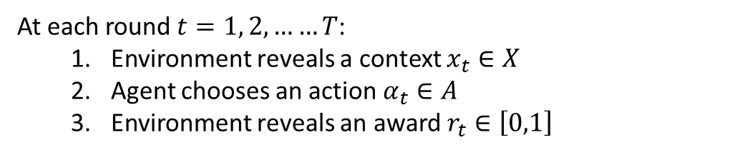
Contextual Bandit Algorithms
At each round $t=1, 2, ……T$:
Environment reveals a context $x_{t}∈X$
Agent chooses an action $α_{t}∈A$
Environment reveals an award $r_{t}∈\left[0,1\right]$
We assume there is an unknown joint distribution over contexts and rewards for all actions, $D_{t}$ (marginal distribution over contexts and conditional distribution over rewards given a context)
Notes:
Learning about the env, making decisions and collecting rewards

Slide 41
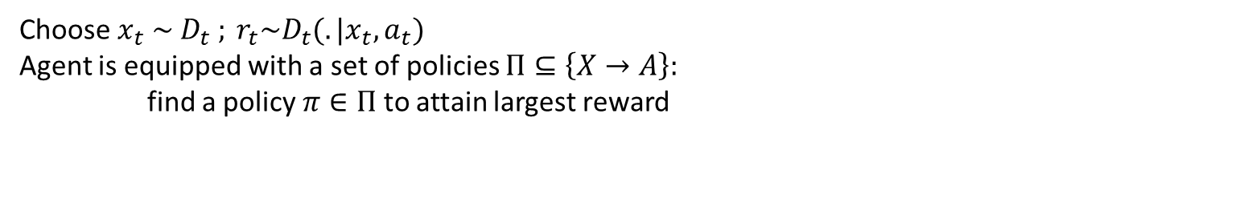
Contextual Bandit Algorithms
At each round $t=1, 2, ……T$:
Environment reveals a context $x_{t}∈X$
Agent chooses an action $α_{t}∈A$
Environment reveals an award $r_{t}∈\left[0,1\right]$
We assume there is an unknown joint distribution over contexts and rewards for all actions, $D_{t}$ (marginal distribution over contexts and conditional distribution over rewards given a context)
Choose$x_{t} \sim D_{t} ; r_{t}\sim D_{t}(.|x_{t}, a_{t})$
Agent is equipped with a set of policies $Π⊆\left\{X→A\right\}:$
find a policy $π∈Π$ to attain largest reward
Notes:
Learning about the env, making decisions and collecting rewards

Slide 42

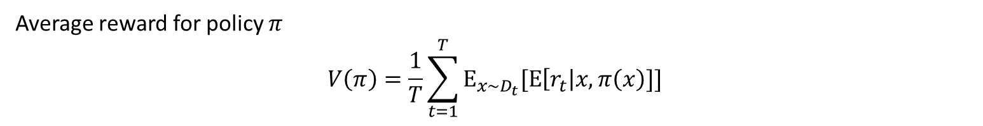
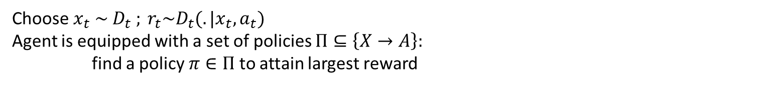
Contextual Bandit Algorithms
At each round $t=1, 2, ……T$:
Environment reveals a context $x_{t}∈X$
Agent chooses an action $α_{t}∈A$
Environment reveals an award $r_{t}∈\left[0,1\right]$
We assume there is an unknown joint distribution over contexts and rewards for all actions, $D_{t}$ (marginal distribution over contexts and conditional distribution over rewards given a context)
Choose$x_{t} \sim D_{t} ; r_{t}\sim D_{t}(.|x_{t}, a_{t})$
Agent is equipped with a set of policies $Π⊆\left\{X→A\right\}:$
find a policy $π∈Π$ to attain largest reward
Expectation of reward given a specific context $x$ and policy $π(x)$
Average reward for policy $π$
$$V\left(π\right)=\frac{1}{T}\sum_{t=1}^{T}{Ε_{x\sim D_{t}}[Ε\left[r_{t}\right|x, π\left(x\right)]]}$$
Notes:
Learning about the env, making decisions and collecting rewards

Slide 43
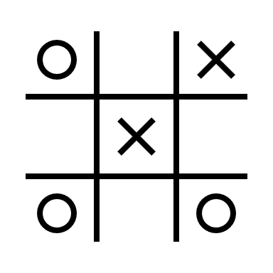
Contextual Bandits: E-commerce - Why not collaborative filtering or A/B Testing?
Goal: Improve customer experience and engagement with personalized ranking
Challenges:
Non-stationary content pool
Change in user preferences over time – how to adapt?
Real time updates to replace requirements for delayed A/B testing

Slide 44
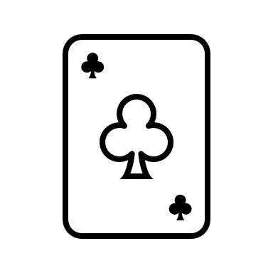
Contextual Bandits: E-commerce - Why not collaborative filtering or A/B Testing?
Goal: Improve customer experience and engagement with personalized ranking
Challenges:
Non-stationary content pool
Change in user preferences over time – how to adapt?
Real time updates to replace requirements for delayed A/B testing
Solution:
Optimize the metrics with contextual bandits
Find the best strategy for a given context; not overall best strategy

Slide 45

Contextual Bandits – Industry Case study
Goal: Which ads to show to a user?
State: User demographics + preferences
Action: Ad types
Reward: Click on ad/No Click on ad

Slide 46

Contextual Bandits – Industry Case study
Goal: Improve customer experience and engagement with personalized ranking of news articles
State: User interests, news article specifics​
Action: category of news article – finance, health, sports etc.​
Reward: click/no click

Slide 47
QUESTIONS

Slide 48
References
Deep Reinforcement Learning:
Human-level control through deep reinforcement learning | Nature
6. Deep Q-Learning | Deep Reinforcement Learning with Python: With PyTorch, TensorFlow and OpenAI Gym (oreilly.com)
Deep Reinforcement Learning (julien-vitay.net)
Multi-Arm Bandits:
Multi-Armed Bandits: Exploration versus Exploitation (stanford.edu)

Slide 49
References
Contextual Bandits:
GitHub - Mathtodon/Contextual_Bandits_Tree: Contains Code for Contextual Bandits Decision Tree
*1802.04064.pdf (arxiv.org)

